Slide 1

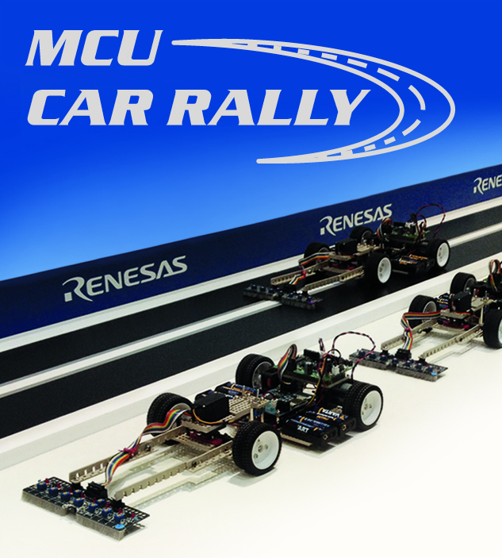
Renesas MCU Car Rally 2018
Faculty of Computing, Engineering and Science
University of South Wales – 2017/18
MEng Group Project
Weekly Report
Students:
13013521 Thomas Brown – MEng Electrical and Electronic Engineering
14031329 Miguel Santos – MEng Computer Systems Engineering
Lecturer:
Prof Gouping Liu

Slide 2
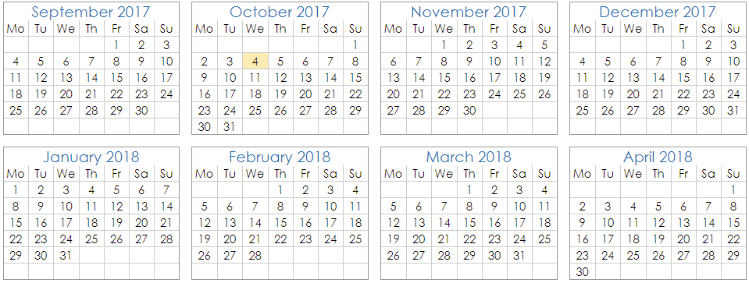
Week 3 – 4 October 2017
Main project goals
Desired features
Roadmap
Current proposals
Discarded feature proposals
Future proposals
Next week…
Extras
MEng Group Project – Renesas MCU Car Rally 2017/18

Slide 3
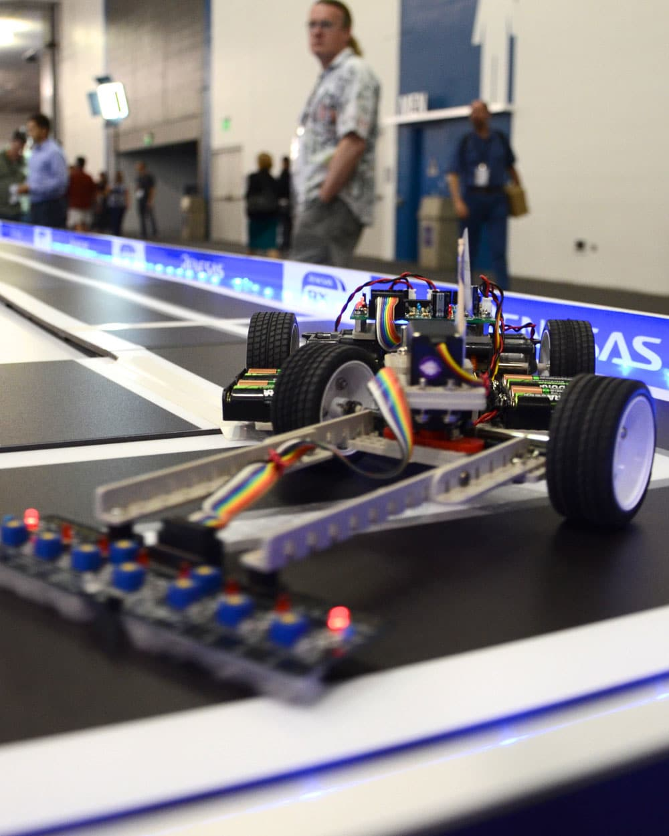
Main project goals
This project aims for:
Improving last year’s car in every aspect (software and hardware)
Ensure the reliability and stability of the car in terms of hardware and drive control
Innovating with clever software techniques to achieve competitive advantage
Win 1st place
MEng Group Project – Renesas MCU Car Rally 2017/18

Slide 4
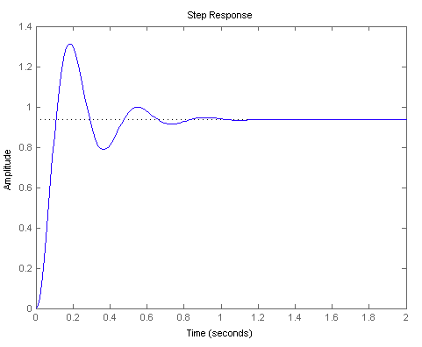
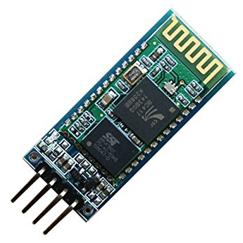
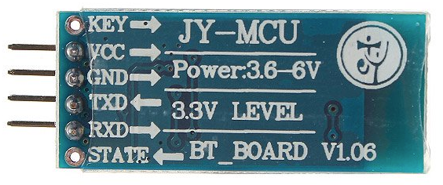
Desired features
In order to achieve these goals, the following “unique” features must be implemented:
An improved and efficient PID controller for the locomotion of the car
Track line mapping/prediction using machine learning algorithms
Simplified wireless link (Bluetooth) for debugging purposes only
MEng Group Project – Renesas MCU Car Rally 2017/18

Slide 5
Desired features
By combining these features, we could:
Prevent instability which could cause the car to lose control and leave the track
Keep the car with its core momentum by reducing slowdowns in every 90º turn
Accelerate the car at its maximum speed on longer tracks (relies on track mapping algorithms)
Easily and quickly deploy/fix software wirelessly, thus speeding up the software development process dramatically
MEng Group Project – Renesas MCU Car Rally 2017/18

Slide 6
Roadmap
Mounting the structure of the car: <1 week
Designing and building extra circuitry: ~1 week
Fixing possible future hardware problems: ~4 days
Developing the core software: ~1.5 weeks (learning curve) + ~2 weeks
Introducing new features to the software (e.g. machine learning): ~2 weeks
Correcting software bugs and finishing off the code into the release stage: ~1.5 weeks
Testing software and hardware: ~3 days
Benchmarking and parameter tuning: ~1 week
MEng Group Project – Renesas MCU Car Rally 2017/18

Slide 7
Roadmap
Summing all up:
~11 weeks
~2.75 months
Rounding up to 3 months as a margin error
Predicted project conclusion:
January / February (Weekends and Christmas Holidays)
MEng Group Project – Renesas MCU Car Rally 2017/18

Slide 8
Current Proposals
The project currently presents itself in the design stage. As of now, the proposed features are:
Mechanical:
Turn the car flat and wider to increase stability
Distribute weight at the back of the car for momentum and stability
Electrical:
Speed controller for DC motor
3-Axis accelerometer (secondary to the speed controller)
Bluetooth module with the component HC-06 (uses standard UART communication)
Software:
Efficient PID controller
Smart line tracker system
Track mapping using speed controller and 3-axis accelerometer
MEng Group Project – Renesas MCU Car Rally 2017/18

Slide 9
Discarded feature proposals
Some features were not feasible however. Such cases are:
Complete removal of the line tracker sensor and replacement with a CMOS VGA Camera 640x480@30 fps (OV7670).
Advantages:
Improved control of the car
“Ahead-of-time” control by the means of detecting a 90º curve at a distance
Issues:
Not enough Microcontroller resources
Algorithm too complex
Not ideal for real-time applications
MEng Group Project – Renesas MCU Car Rally 2017/18

Slide 10
Future proposals
In addition to improving the current proposals, we will also be planning to add:
Line tracker sensor control aid – needs research.
Complex data logging – collects the car’s movement data and plots into a graph what an ideal path should look like versus what the actual data is. This will let us know what parameters need to be tuned.
MEng Group Project – Renesas MCU Car Rally 2017/18

Slide 11
Next week…
According to the roadmap, next week’s report should cover the car’s hardware, which includes the speed controller for the DC motor.
If the hardware is still not available this week, then the focus will be redirected into the design and planning of the project; mainly into the feature proposals and the circuit design of the speed controller.
MEng Group Project – Renesas MCU Car Rally 2017/18

Slide 12
Extras
This project is being created and hosted on the GitHub website, at the URL below:
https://github.com/miguelangelo78/Renesas-MCU-Car-Rally-2018-USW
In addition, the team members are using Skype as a means of communication
MEng Group Project – Renesas MCU Car Rally 2017/18

Slide 13
Questions?

